Slide 1
Shoreline Assessment and Clean-up
CGPRT(W) : Ensuring Clean Seas and Coasts in Western Region ……

Slide 2
Objective
To understand the importance of shoreline assessment and the various clean-up techniques in order to reduce environmental damages.
CGPRT(W) : Ensuring Clean Seas and Coasts in Western Region ……

Slide 3
Shoreline Assessment
In order to make decisions on shoreline treatment and response operations, management requires real-time data on oiling conditions.
This is the purpose of shoreline assessment and of a SCAT Team
(Shoreline Clean-up Assessment Technique)
CGPRT(W) : Ensuring Clean Seas and Coasts in Western Region ……

Slide 4
Shoreline Assessment
Pre-spill planning phase
Contingency plans
Pre-SCAT data (such as mapping and segmentation)
Resource maps
CGPRT(W) : Ensuring Clean Seas and Coasts in Western Region ……

Slide 5
Shoreline Assessment
Response phase
Implement contingency plans
Review pre-SCAT data
SCAT surveys
Recommend shoreline protection and treatment
CGPRT(W) : Ensuring Clean Seas and Coasts in Western Region ……

Slide 6
Shoreline Assessment Principles
Identify oiled and non-oiled areas
Identify location, amount and character of oil
Evaluate operational and logistical factors
Establish shoreline treatment priorities
Establish treatment standards
Propose treatment methods
Consider how proposed operations can prevent any additional damage
CGPRT(W) : Ensuring Clean Seas and Coasts in Western Region ……

Slide 7
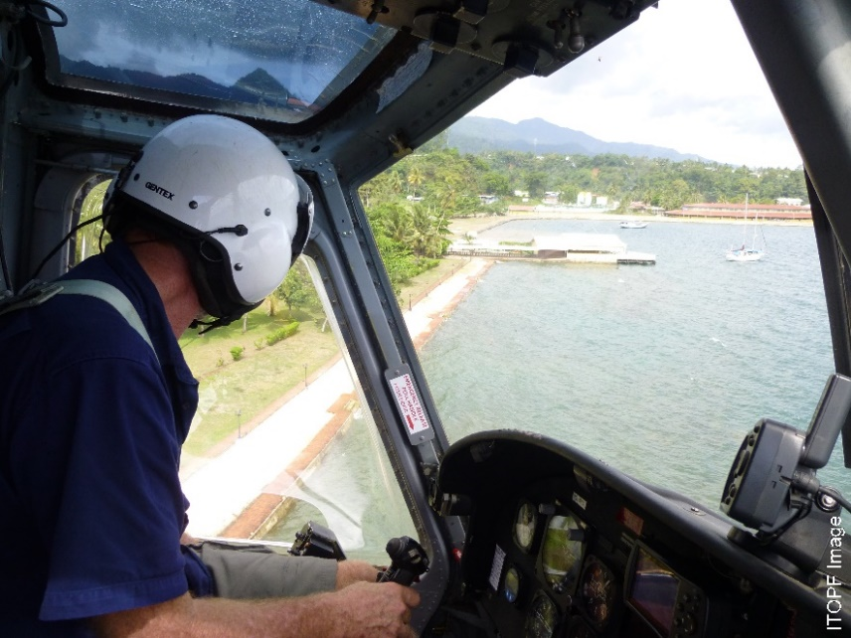
Aerial Survey
Aerial reconnaissance using observations, photos, and video
Provides an overall picture of the situation in a short amount of time
Source: ITOPF
CGPRT(W) : Ensuring Clean Seas and Coasts in Western Region ……

Slide 8
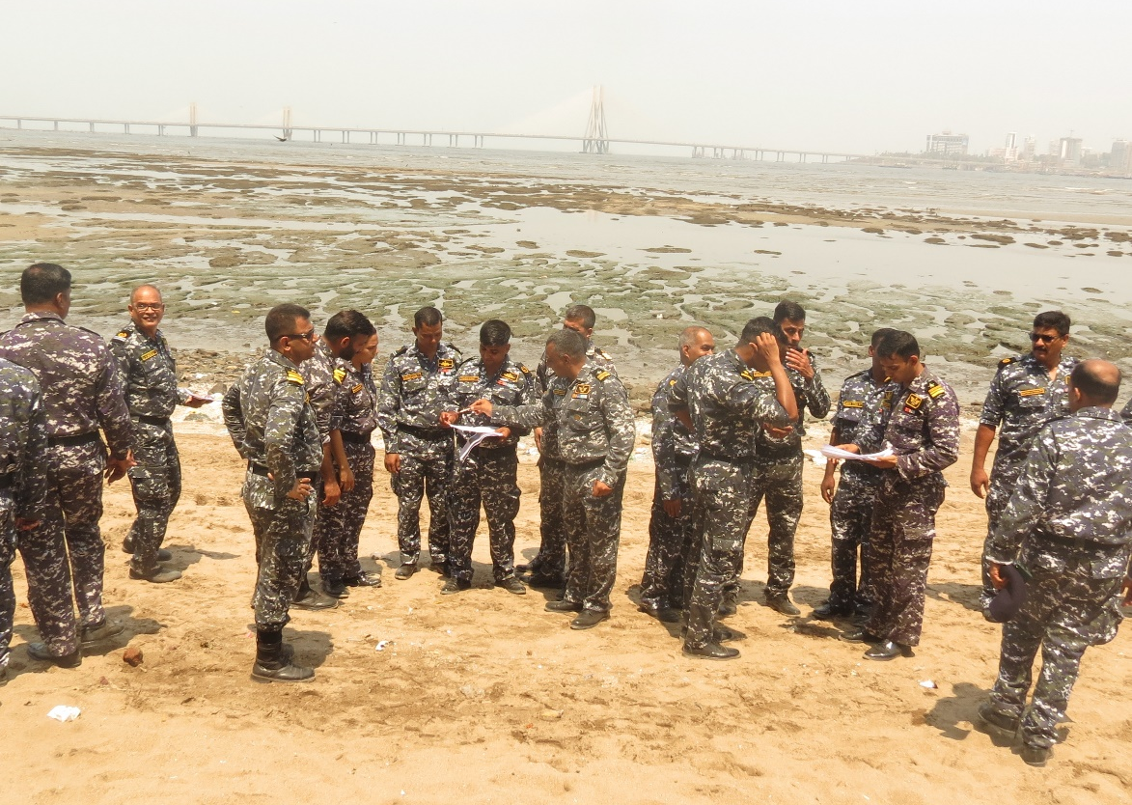
Ground Survey
Provide more detailed information
May require a number of teams with differing skills
Can be done in addition to continuing aerial surveys
CGPRT(W) : Ensuring Clean Seas and Coasts in Western Region ……

Slide 9
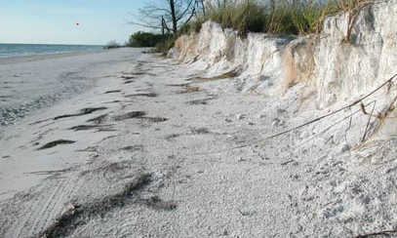
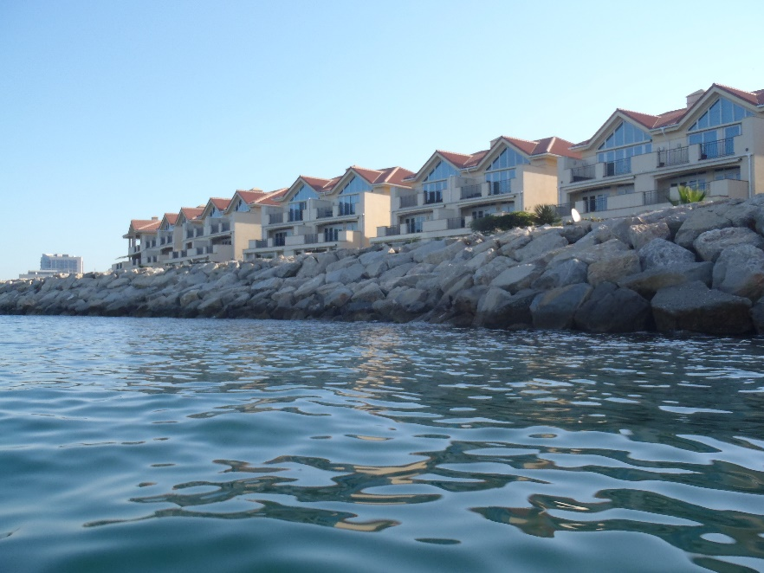
Describe Coastal Conditions
Overview of characteristics of affected shore including load-bearing capacity
Operational activities take place in the backshore zone and this needs to be characterized.
Source : OSRL
Source : OSRL
CGPRT(W) : Ensuring Clean Seas and Coasts in Western Region ……

Slide 10
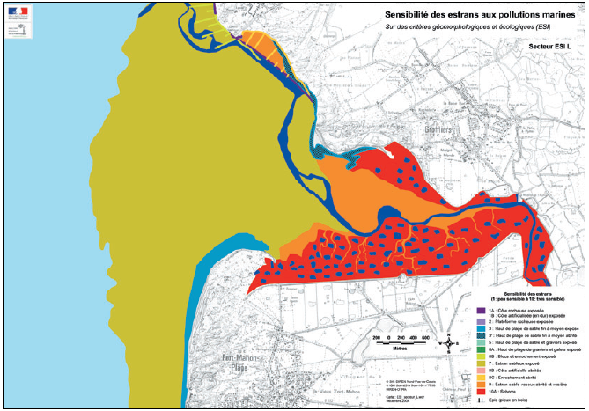
Shoreline Mapping
Example of shoreline mapping and environ-mental sensitivity using ESI
Source: IPIECA/IMO/IOGP. Sensitivity Mapping for Oil Spill Response
CGPRT(W) : Ensuring Clean Seas and Coasts in Western Region ……

Slide 11
Describe Oiling Conditions
Surface oil distribution
Surface oil thickness
Oil character
Subsurface oil
CGPRT(W) : Ensuring Clean Seas and Coasts in Western Region ……

Slide 12
SCAT Team
Made up of representatives for key stakeholders
Kept to a manageable size
Team members consult on oiling conditions for each segment and gain consensus to ensure an accurate unbiased view
CGPRT(W) : Ensuring Clean Seas and Coasts in Western Region ……

Slide 13
SCAT Management
SCAT coordinator
Manages the team’s activities and coordinates with:
Shoreline operations
Documentation
Logistics/Air ops
CGPRT(W) : Ensuring Clean Seas and Coasts in Western Region ……

Slide 14
SCAT Management
SCAT Logistics coordinator
Takes care of the day-to-day field/office needs of the SCAT teams with respect to:
Logistics – transportation, meals, water, supplies, field equipment
Safety – PPE
CGPRT(W) : Ensuring Clean Seas and Coasts in Western Region ……

Slide 15
SCAT Management
SCAT Data manager
Handles incoming field data, QA/QC and output products as required
CGPRT(W) : Ensuring Clean Seas and Coasts in Western Region ……

Slide 16
Stages of Shoreline Clean-up
Normally not an emergency – a project lasting weeks, months, years.
Stage 1. Removal of gross pollution and bulk oil
Stage 2. Removal of remaining stranded oil and oiled shoreline materials/debris
Stage 3. Final polishing/aesthetic treatment
CGPRT(W) : Ensuring Clean Seas and Coasts in Western Region ……

Slide 17
Treatment Recommendations
Overall objective of shoreline treatment is to
remove the oil or
to accelerate the natural recovery and
avoid causing more damage by clean-up operations
CGPRT(W) : Ensuring Clean Seas and Coasts in Western Region ……

Slide 18
Treatment Recommendations
In order to make shoreline treatment recommendations:
Endpoints must be determined
Treatment methods are based on shoreline type and oil behaviour
Consider net environmental benefit when making recommendations
CGPRT(W) : Ensuring Clean Seas and Coasts in Western Region ……

Slide 19
Shoreline Treatment Methods
Natural recovery
Physical methods
Washing
Removal and disposal
In situ treatment
Chemical and biological methods
CGPRT(W) : Ensuring Clean Seas and Coasts in Western Region ……

Slide 20
Natural Recovery
Estimate persistence and recovery
Will treatment accelerate recovery?
All treatment has an environmental effect – will the NEB be positive or negative?
What are the social/economic factors?
What are the safety issues?
CGPRT(W) : Ensuring Clean Seas and Coasts in Western Region ……

Slide 21
Physical Methods – Washing
Objective
This group of methods involves a variety of washing or flushing techniques that are used to remobilize and recover oil.
CGPRT(W) : Ensuring Clean Seas and Coasts in Western Region ……

Slide 22
Washing
Washing
Flooding
Low pressure washing – cold
Low pressure washing – warm/hot
High pressure washing – cold
High pressure washing – warm/hot
Steam cleaning
Sandblasting
CGPRT(W) : Ensuring Clean Seas and Coasts in Western Region ……

Slide 23
Washing
Technique | Pressure Range Bars PSI |  | Temperature Range °C °F
Flooding | < 1.5 | < 20 | Ambient sea water
Low-pressure: cold flushing | < 3 | < 50 | Ambient sea water
Low-pressure: warm/hot flushing | < 3 | < 50 | 30-100 | 90-210
High-pressure: cold flushing | 4-70 > 70 | 50-1000 > 1000 | Ambient sea water
High-pressure: warm/hot flushing | 4 – 70 | 50-1000 | 30-100 | 90-210
Steam cleaning | 4 – 70 | 50-1000 | > 100 | > 210
Sandblasting | ~ 4 | ~ 50 | N/A
CGPRT(W) : Ensuring Clean Seas and Coasts in Western Region ……

Slide 24
Technique | Objective | Optimum use
Flooding | Flood a site so that mobile oil is lifted and carried downslope to a collection area | Most shoreline type Light to medium oils
Low-pressure, cold wash | Wash or flush oils toward a collection area using ambient sea, lake or river water at low pressure | Impermeable shorelines and marsh Light to medium oils
Low-pressure, warm/hot wash | Wash or flush oils at low pressure, using heated water, toward a collection area | Impermeable shorelines Light to medium oils
High-pressure, cold wash | Wash or flush oils toward a collection area using ambient sea, lake or river water at high pressure | Impermeable shorelines medium to heavy oils
High-pressure, warm/hot wash | Wash or flush oils at high pressure, using heated water, toward a collection area | Impermeable shorelines medium to heavy oils
Steam cleaning | Remove stains or dislodge thin layers of viscous oil from hard surface | Impermeable man-made structures Stains or heavy, weathered oils
CGPRT(W) : Ensuring Clean Seas and Coasts in Western Region ……

Slide 25
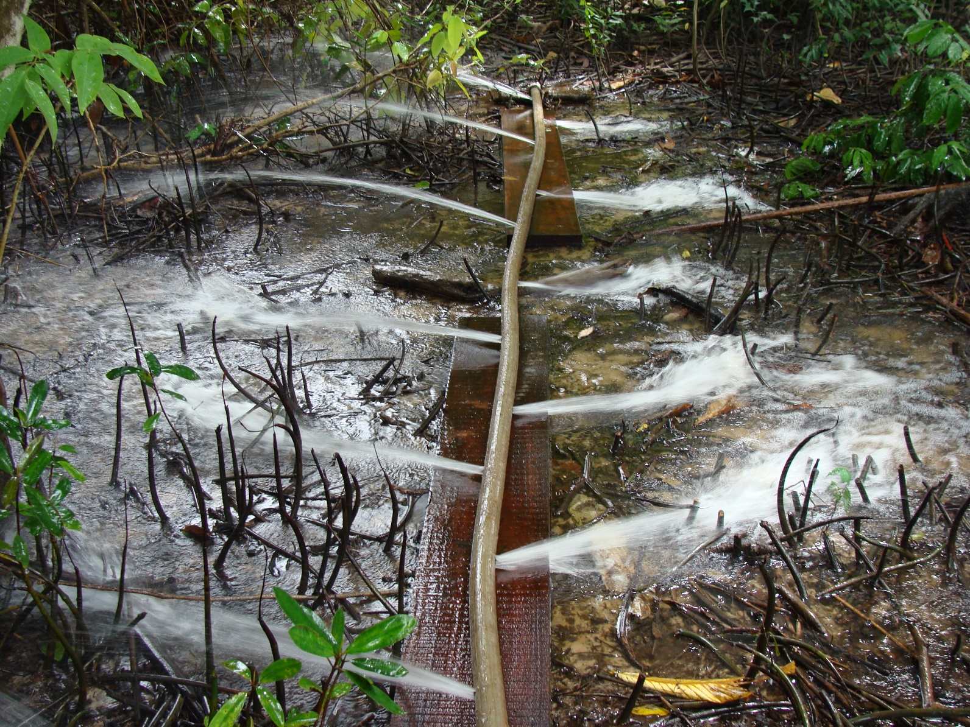
Flooding
Source: OSRL
CGPRT(W) : Ensuring Clean Seas and Coasts in Western Region ……

Slide 26
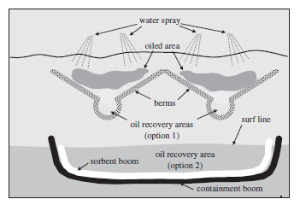
Low Pressure Washing
Source: Exxon Mobil
CGPRT(W) : Ensuring Clean Seas and Coasts in Western Region ……

Slide 27
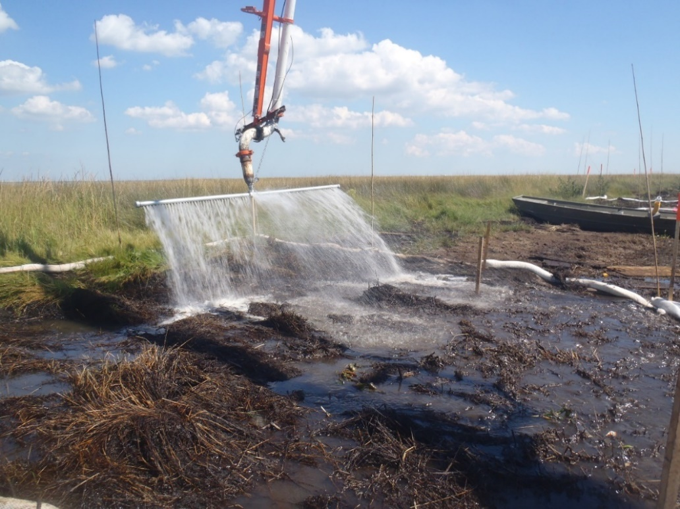
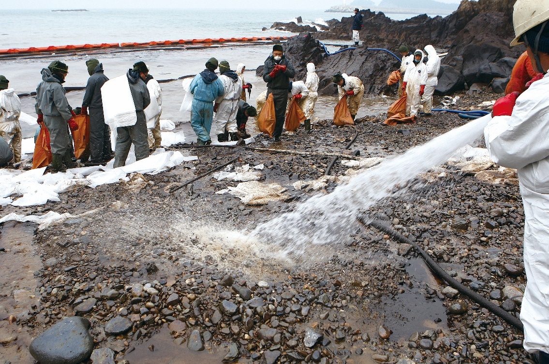
Low Pressure Washing
Source: OSRL
Source: Korea Coast Guard
CGPRT(W) : Ensuring Clean Seas and Coasts in Western Region ……

Slide 28
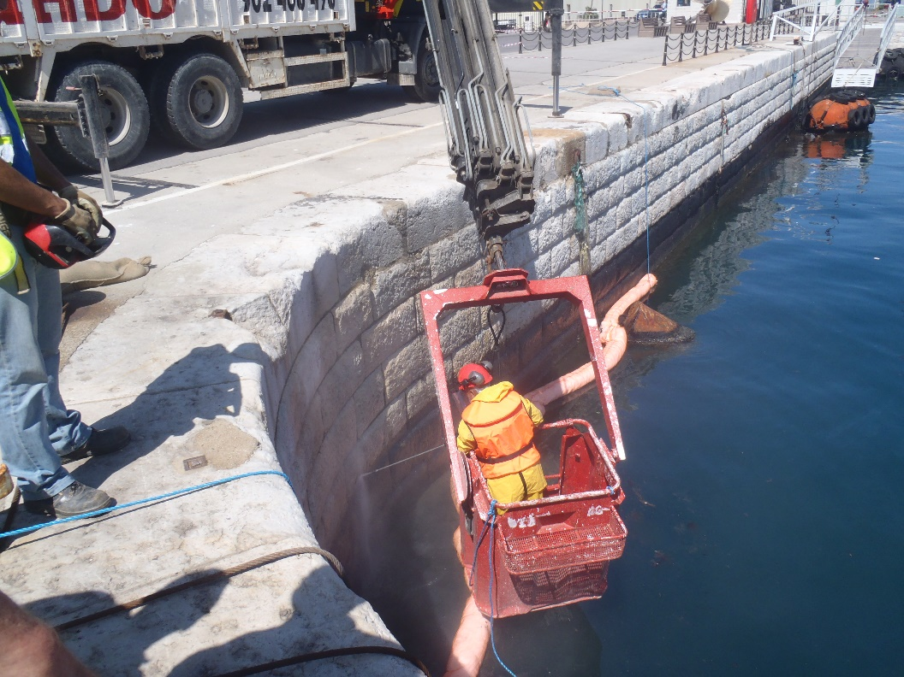
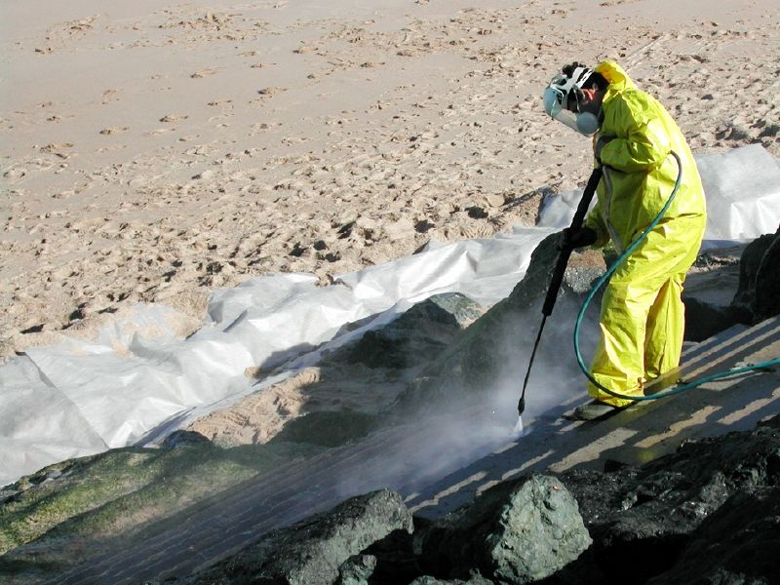
High Pressure Washing
Source: OSRL
Source: CEDRE
CGPRT(W) : Ensuring Clean Seas and Coasts in Western Region ……

Slide 29
Physical methods − Removal
Objective
This group of physical methods involves removal of the oil or oiled material (sediments, debris, vegetation) from the shore zone for disposal.
CGPRT(W) : Ensuring Clean Seas and Coasts in Western Region ……

Slide 30
Technique | Objective | Optimum use
Manual removal | Remove oil or oiled material (including oiled snow/ice) with manual labour and hand tool | Most shoreline types Small amounts of surface oil
Vacuum systems | Remove oil by suction from areas where it has pooled or collected in sumps | Light to medium, non-volatile, pooled or collected oil
Mechanical removal | Remove oil and oiled materials using mechanical equipment | Most fine to coarse-sediment beaches Large volumes of medium, heavy or solid oil
Vegetation cutting | Remove oiled stems to prevent remobilization of the oil or contact by animals and birds, or to accelerate the recovery of the plant. | Marshes, vegetated shorelines Where remobilization of oil will affect other resources.
Passive sorbents | Place sorbents in a fixed location(s) so that they pick up oil by contact | Any shoreline type Light to heavy, non-solid, non-volatile oils
CGPRT(W) : Ensuring Clean Seas and Coasts in Western Region ……

Slide 31
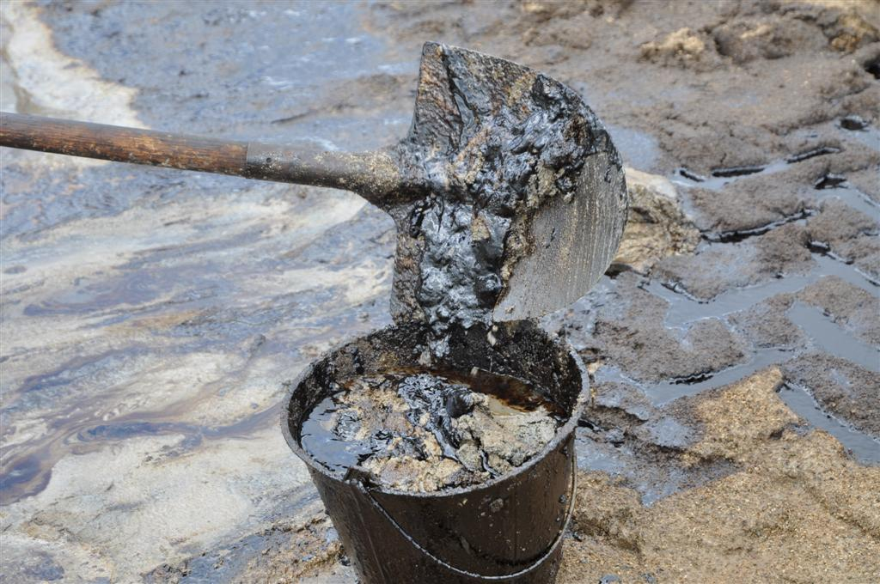
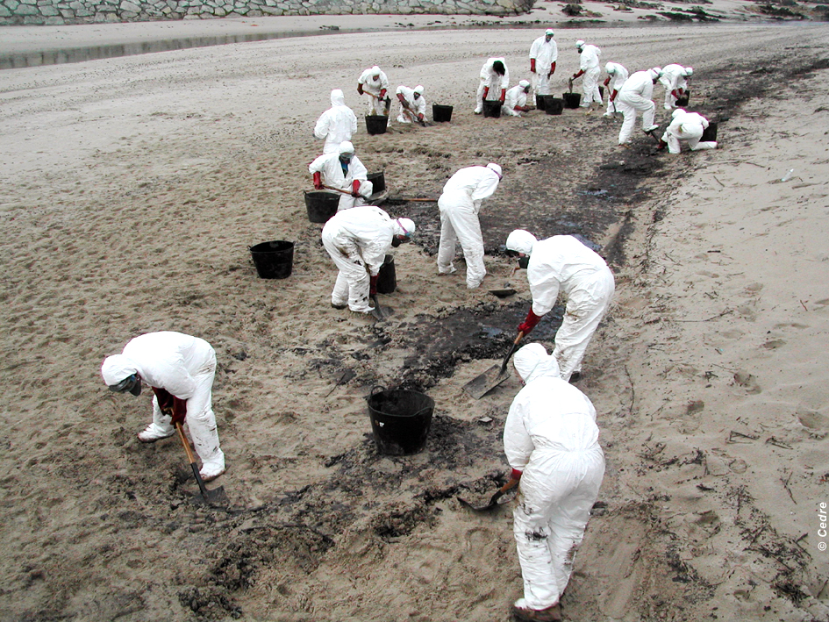
Manual Removal
Source: OSRL
Source: CEDRE
CGPRT(W) : Ensuring Clean Seas and Coasts in Western Region ……

Slide 32
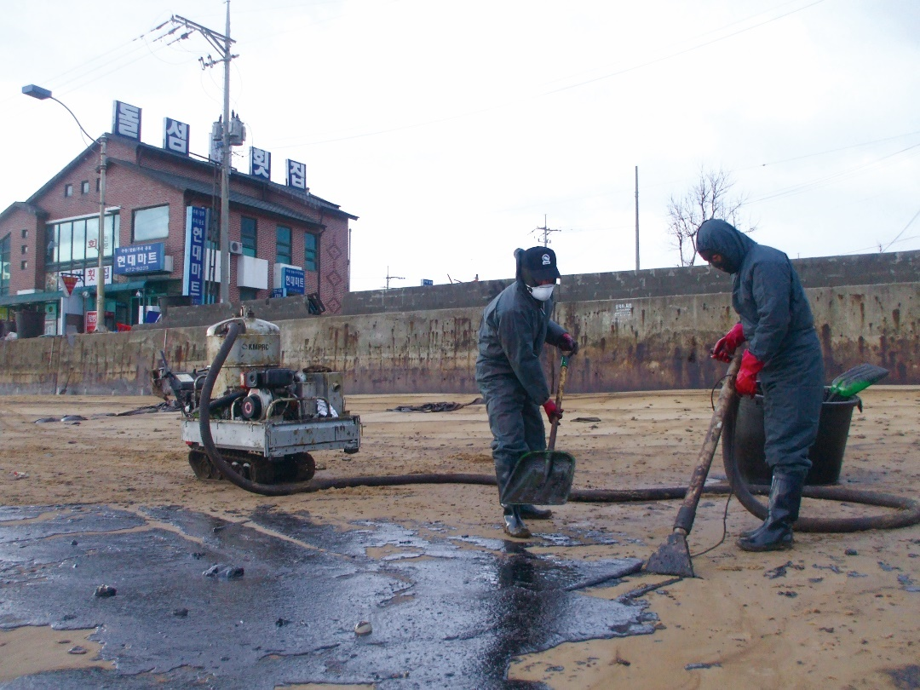
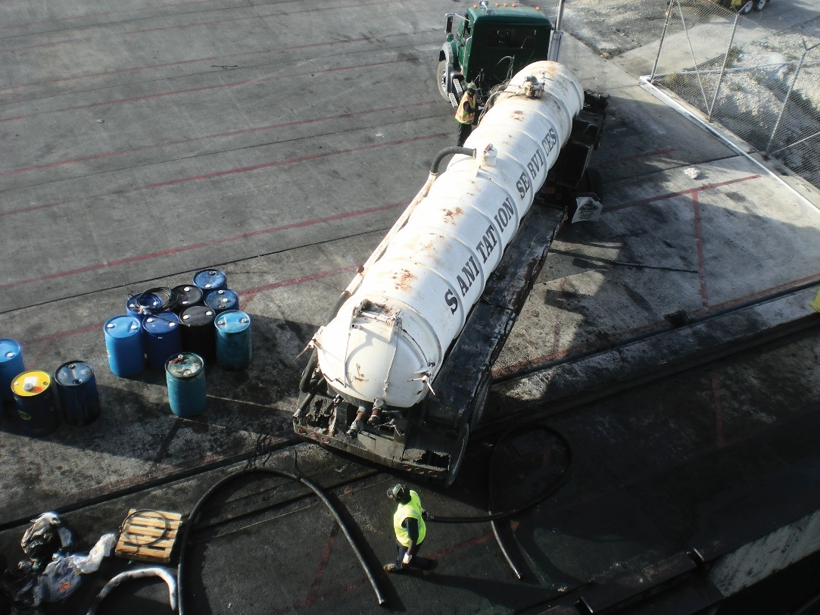
Vacuum Systems
Source: Korea Coast Guard
Source: OSRL
CGPRT(W) : Ensuring Clean Seas and Coasts in Western Region ……

Slide 33
Mechanical Removal
Important to consider bearing capacity of shoreline and other legal restrictions for heavy machinery
CGPRT(W) : Ensuring Clean Seas and Coasts in Western Region ……

Slide 34
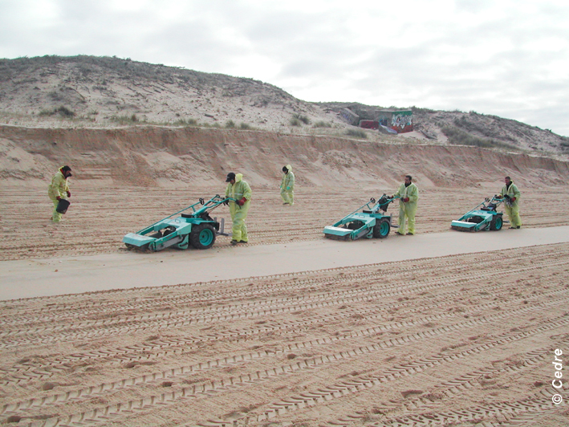
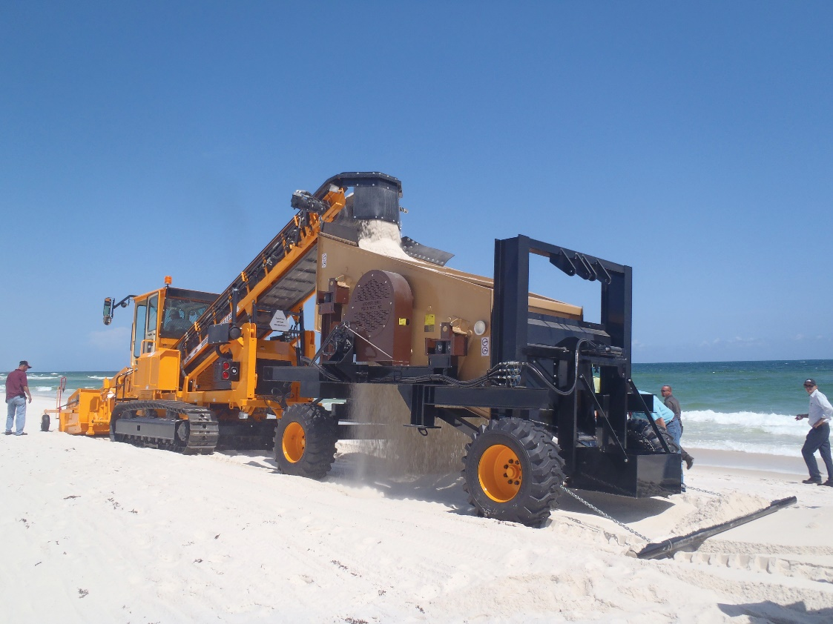
Mechanical Removal
Source: OSRL
Source: CEDRE
CGPRT(W) : Ensuring Clean Seas and Coasts in Western Region ……

Slide 35
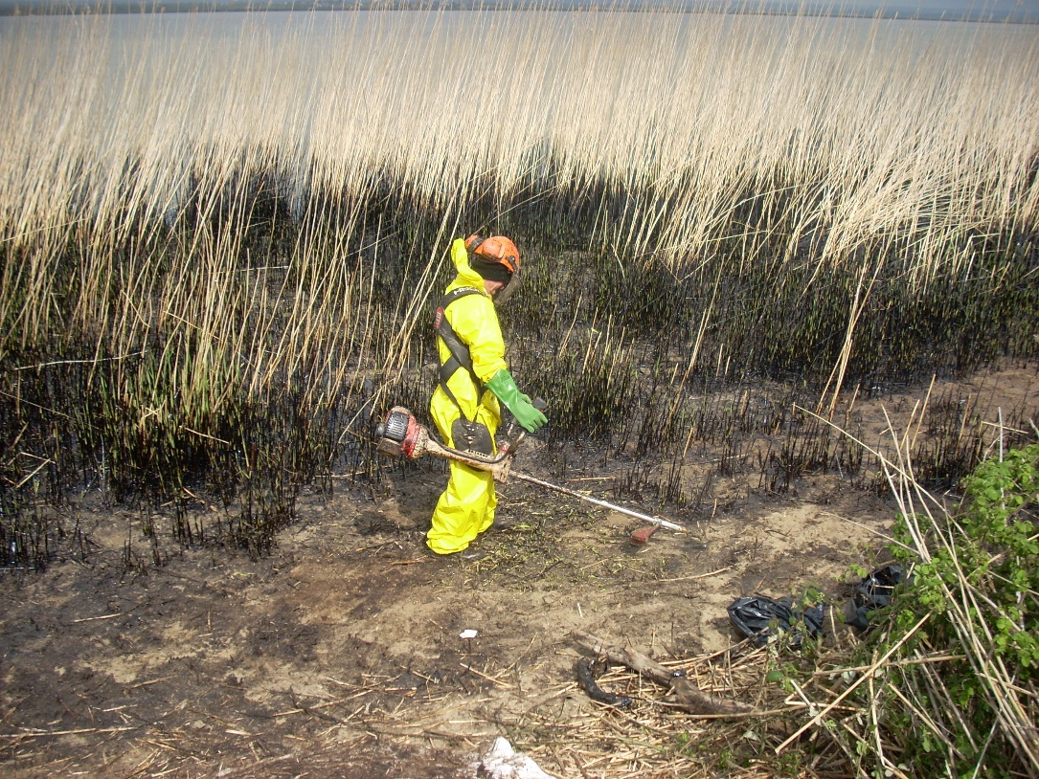
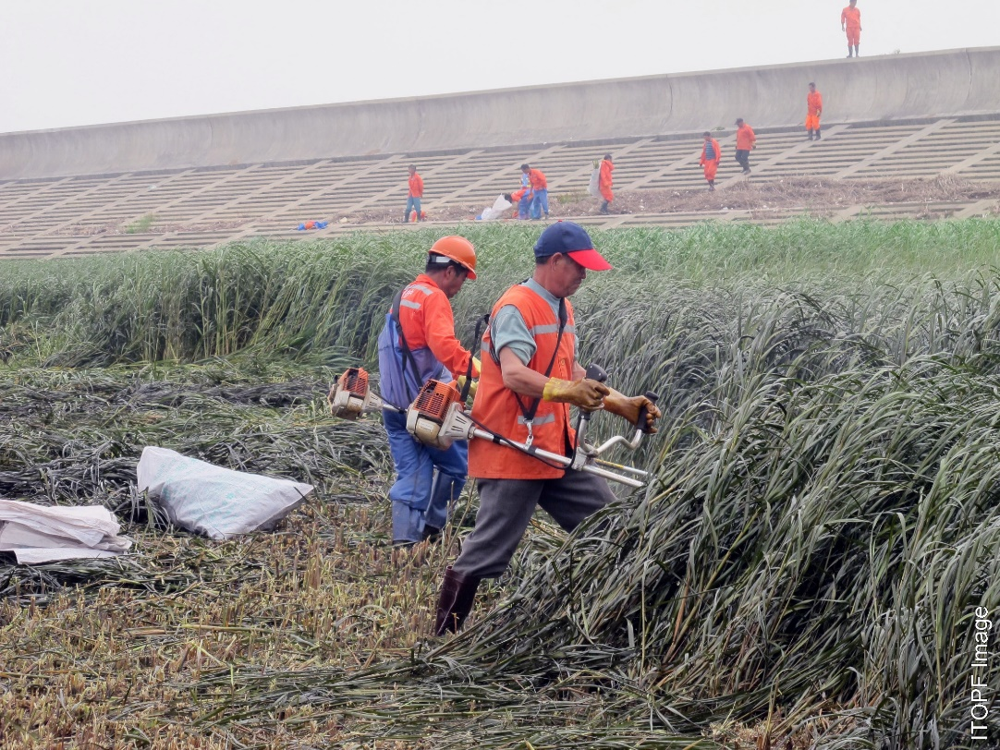
Vegetation Cutting
Source: CEDRE
Source: ITOPF
CGPRT(W) : Ensuring Clean Seas and Coasts in Western Region ……

Slide 36
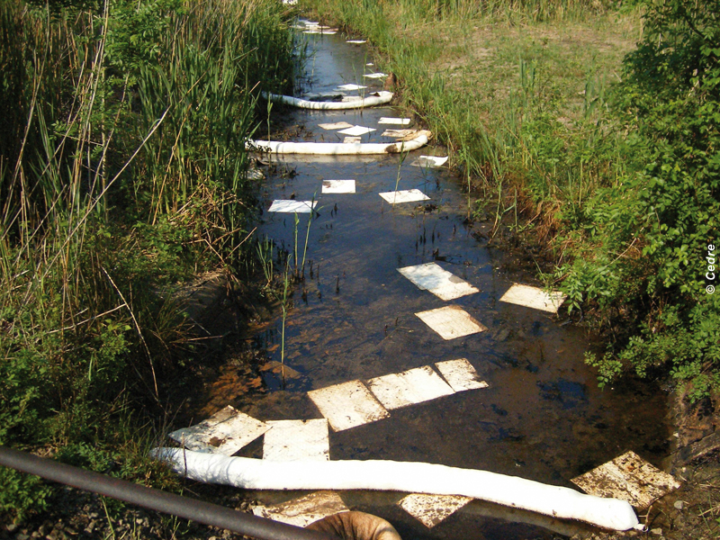
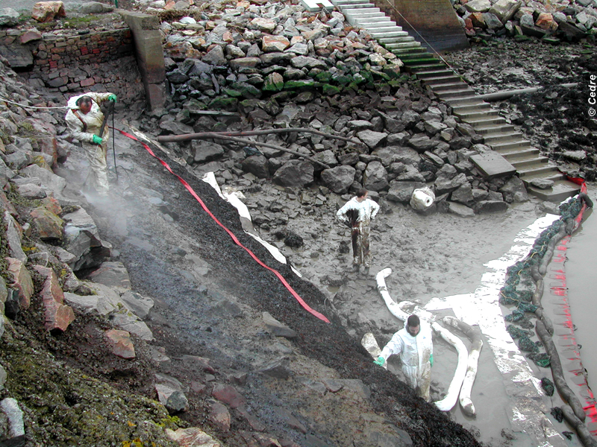
Sorbents
Source: CEDRE
Source: CEDRE
CGPRT(W) : Ensuring Clean Seas and Coasts in Western Region ……

Slide 37
Disposal
Waste management is a critical component to response operations
Segregation and minimization
Can cause a bottle-neck
CGPRT(W) : Ensuring Clean Seas and Coasts in Western Region ……

Slide 38
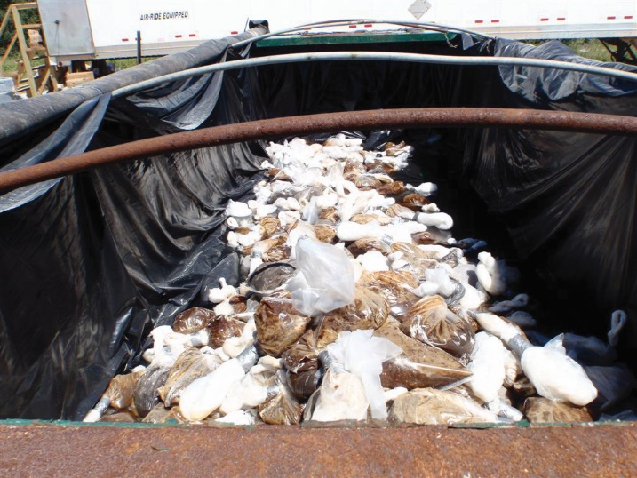
Disposal
Oily waste and debris removal
Minimize sediment removal
Source: OSRL
CGPRT(W) : Ensuring Clean Seas and Coasts in Western Region ……

Slide 39
Physical Methods – In Situ Treatment
Objective
This group of methods involves physical, on-site treatment techniques to promote or increase weathering and natural degradation.
Mechanical tilling/Mixing
Sediment reworking/Surf washing
Burning
CGPRT(W) : Ensuring Clean Seas and Coasts in Western Region ……

Slide 40
In Situ – Tilling/Mixing
accelerate natural weathering penetrated or buried oil without sediment removal or waste generation
break up a surface oil cover before or after a resistant asphalt pavement forms
expose subsurface oil that might have been missed by the clean-up
release/recover oil by underwater agitation in a stream or during a rising tide without sediment removal
CGPRT(W) : Ensuring Clean Seas and Coasts in Western Region ……

Slide 41
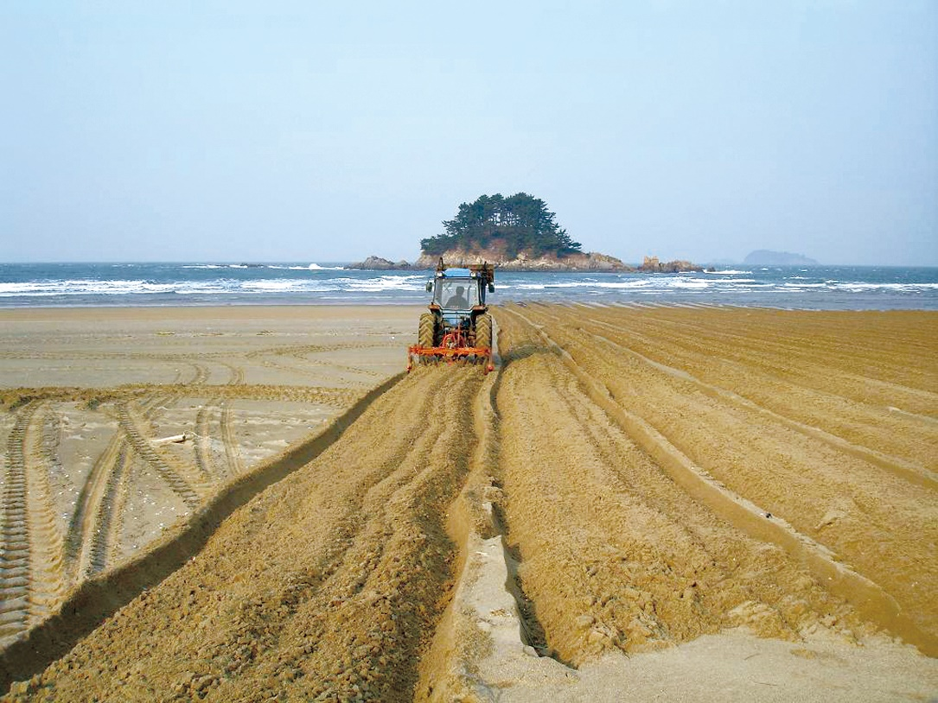
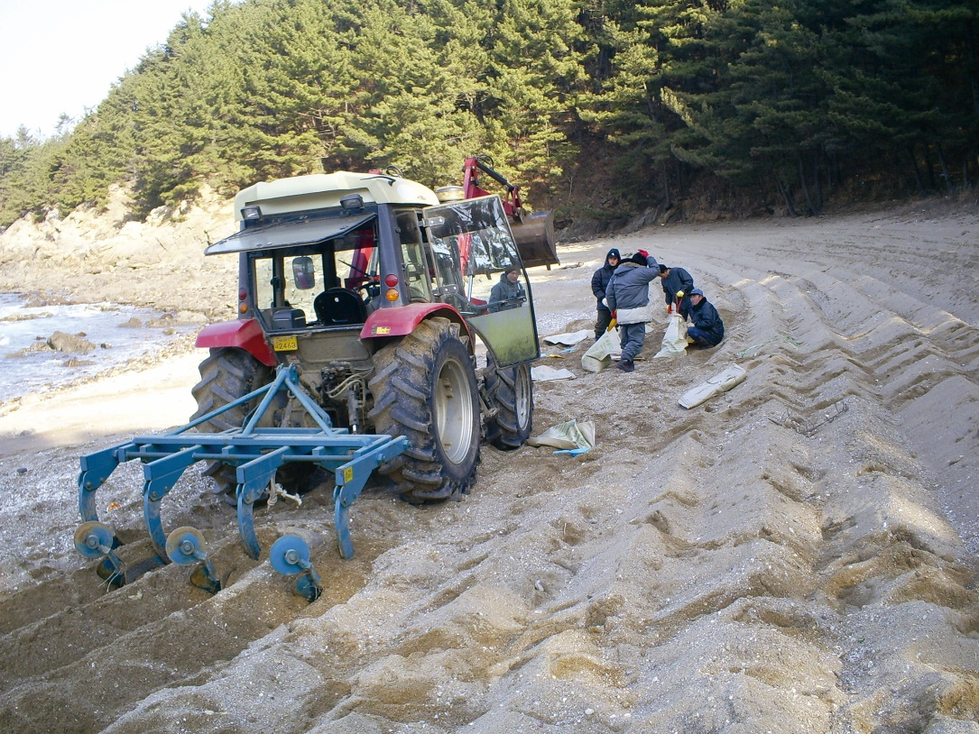
Mechanical Tilling
Source: Korea Coast Guard
Source: Korea Coast Guard
CGPRT(W) : Ensuring Clean Seas and Coasts in Western Region ……

Slide 42
In Situ – Sediment Surf Washing
move oiled sediments from one section of a beach to another in order to accelerate the natural removal of oil
oiled sediments are moved to an area where the physical action of waves is greater and is sustained for longer periods
involves no sediment removal
CGPRT(W) : Ensuring Clean Seas and Coasts in Western Region ……

Slide 43
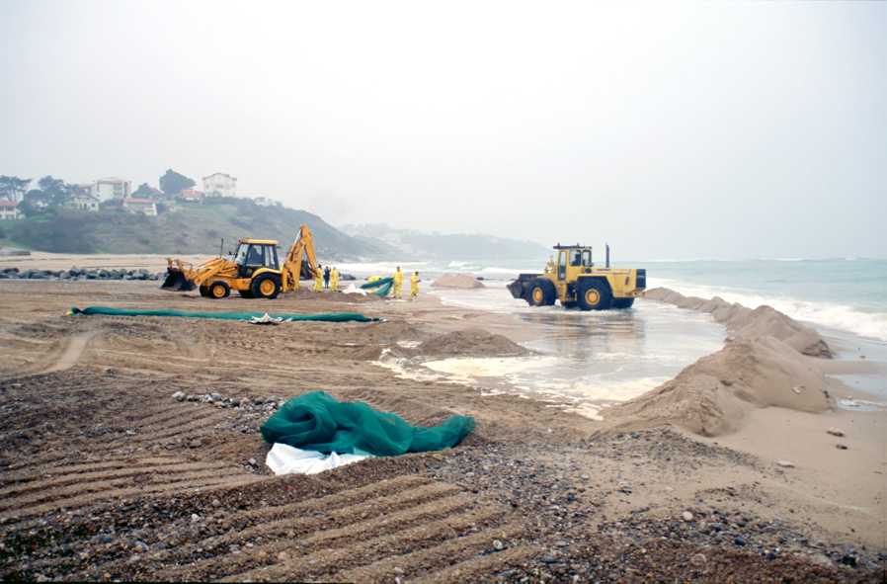
Sediment Reworking/Surf Washing
Source: CEDRE
CGPRT(W) : Ensuring Clean Seas and Coasts in Western Region ……

Slide 44
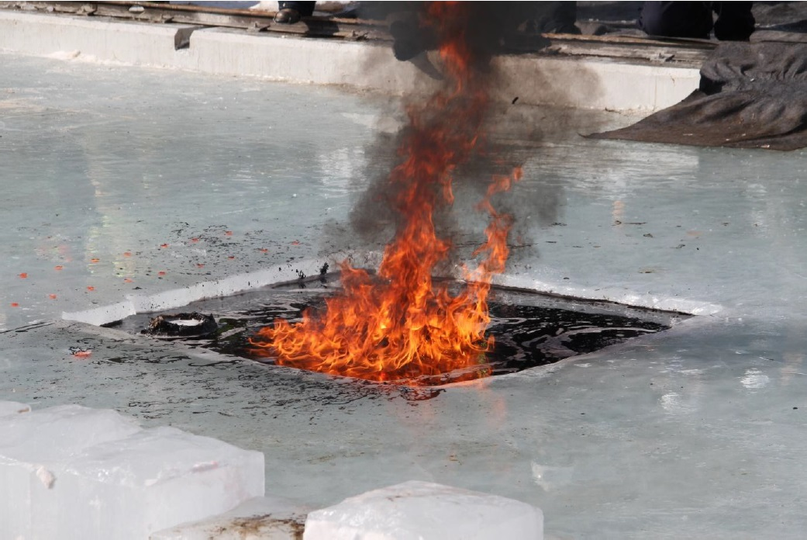
Burning
Source: OSRL
CGPRT(W) : Ensuring Clean Seas and Coasts in Western Region ……

Slide 45
Chemical/Biological Methods
Shoreline cleaners
Solidifiers
Bioremediation
CGPRT(W) : Ensuring Clean Seas and Coasts in Western Region ……

Slide 46
Chemical/Biological Methods
Objective
Facilitate removal of the oil from the shore zone
Accelerate in situ weathering
CGPRT(W) : Ensuring Clean Seas and Coasts in Western Region ……

Slide 47
Shoreline Cleaning Agents
Oil is removed from solid surfaces
Contains surfactants, solvents and/or other additives
Requires appropriate PPE
CGPRT(W) : Ensuring Clean Seas and Coasts in Western Region ……

Slide 48
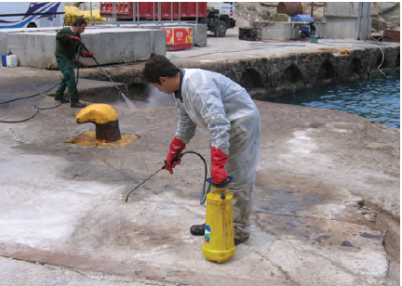
Shoreline Cleaning Agents
Source: ITOPF
CGPRT(W) : Ensuring Clean Seas and Coasts in Western Region ……

Slide 49
Solidifiers
Solidifiers
Form a physical bond with the oil
Oil becomes solidified to a rubber like substance
Comes in various forms (powder, granule, semi-solid forms)
Must be contained and recovered
CGPRT(W) : Ensuring Clean Seas and Coasts in Western Region ……

Slide 50
Bioremediation
Objective
accelerate the rate of degradation, typically by adding nutrients or oxygen to aid and increase natural bacteria – scope for effective use is limited
Rate will vary with
Oil composition
Surface area of oil exposed to bacteria
Availability of nutrients
Air/water temperature
CGPRT(W) : Ensuring Clean Seas and Coasts in Western Region ……

Slide 51
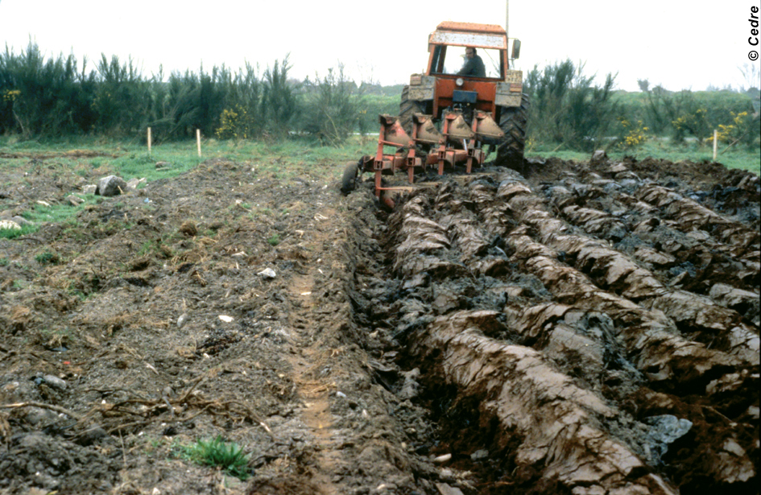
Bioremediation
Source: CEDRE
CGPRT(W) : Ensuring Clean Seas and Coasts in Western Region ……

Slide 52
Conclusion
SCAT teams are the “eyes” of Incident Command providing real-time data on oiling conditions
Shoreline treatment recommendations are made considering the net environmental benefit as well as logistical, operational and safety constraints
CGPRT(W) : Ensuring Clean Seas and Coasts in Western Region ……

Slide 53
Any questions?
CGPRT(W) : Ensuring Clean Seas and Coasts in Western Region ……

